Slide 1


COEP Technological University
A Unitary Public University of Govt. of Maharashtra
Formerly College of Engineering Pune

Slide 2

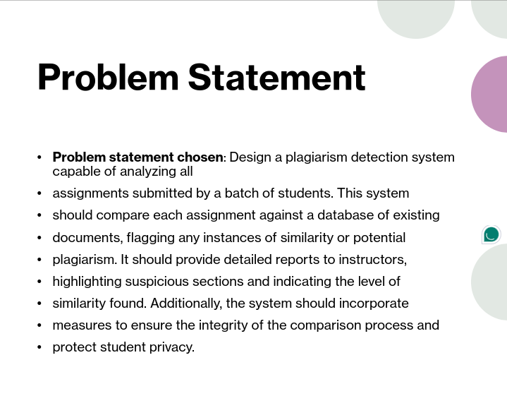
COEP Technological University
A Unitary Public University of Govt. of Maharashtra
Formerly College of Engineering Pune

Slide 3
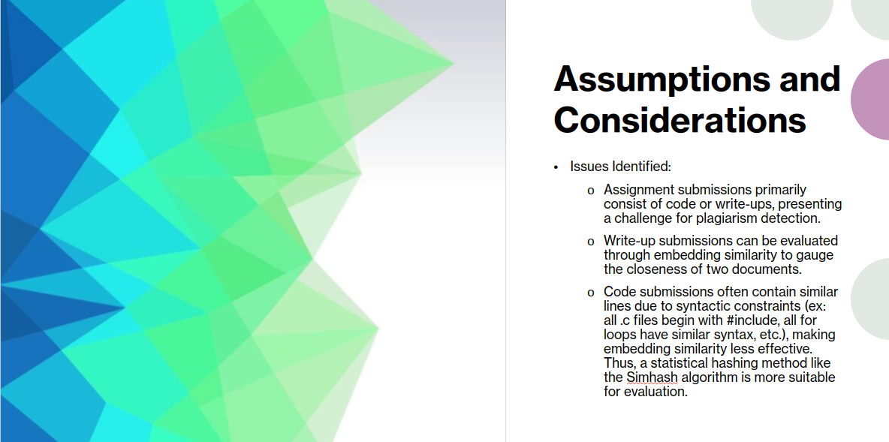
COEP Technological University
A Unitary Public University of Govt. of Maharashtra
Formerly College of Engineering Pune

Slide 4
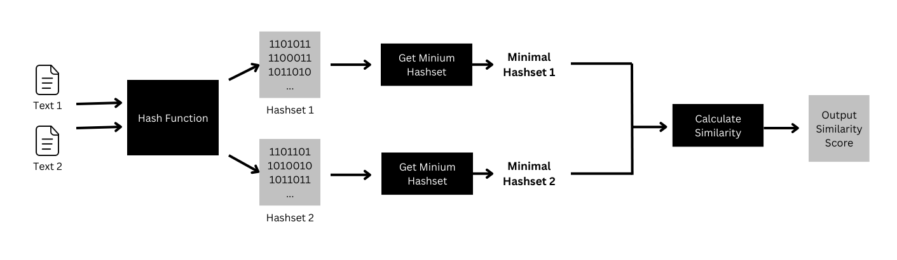
SimHash Working
COEP Technological University
A Unitary Public University of Govt. of Maharashtra
Formerly College of Engineering Pune

Slide 5
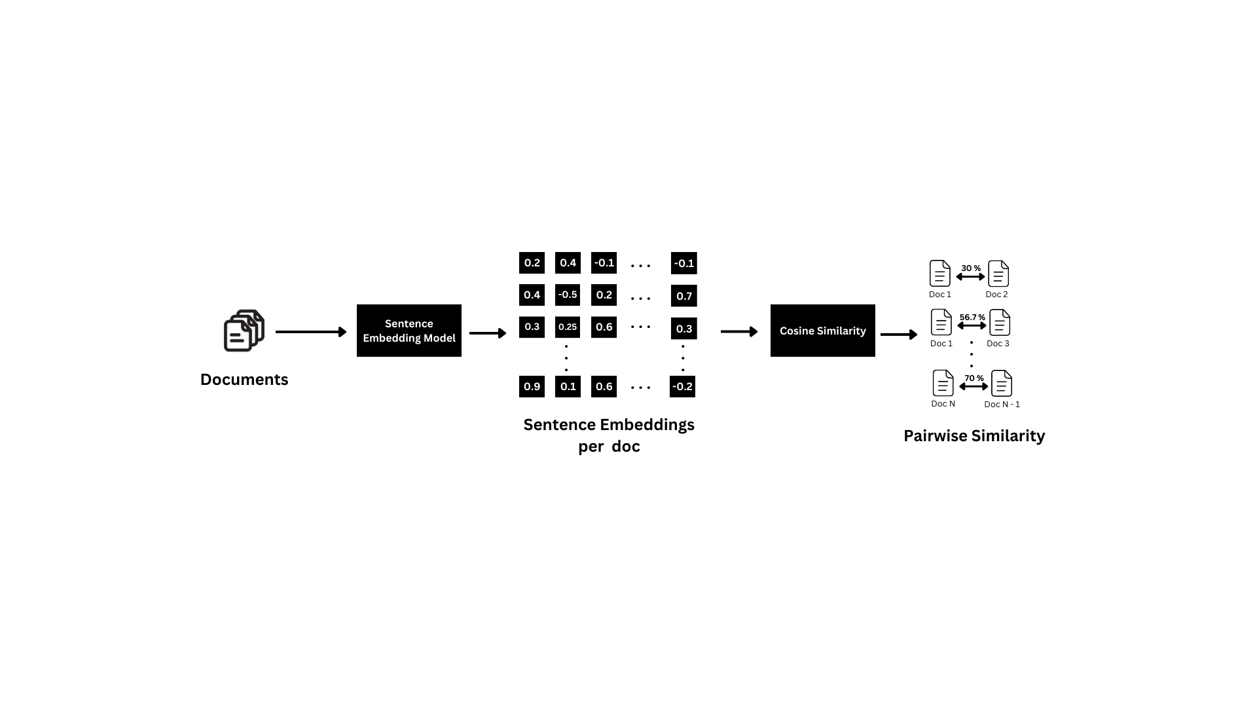
Embedding Similarity Working
COEP Technological University
A Unitary Public University of Govt. of Maharashtra
Formerly College of Engineering Pune

Slide 6
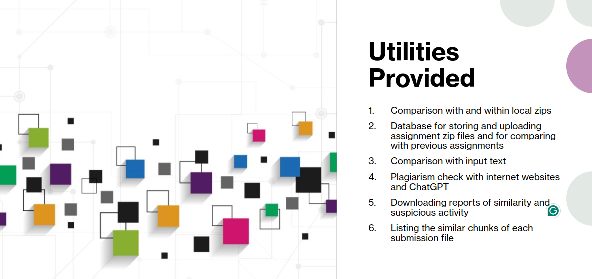
COEP Technological University
A Unitary Public University of Govt. of Maharashtra
Formerly College of Engineering Pune

Slide 7
Cloud Compatible Database
Referencing content via webscraping for:
Assignments
Writeups and Research Papers
Comparing with ChatGPT responses
Custom text data source cross reference
Unique Selling Points
COEP Technological University
A Unitary Public University of Govt. of Maharashtra
Formerly College of Engineering Pune

Slide 8

Future Scope
Better paid cloud storage providers for scraping and archiving more web page results
Optimizing the current similarity score algorithms (speed and performance)
Better UI/UX
Automated detection and replenishment of API keys
Integration of paid API services for AI content detection
COEP Technological University
A Unitary Public University of Govt. of Maharashtra
Formerly College of Engineering Pune

Slide 9

THANK YOU
Atharva Mutsaddi
Aditya Choudhary
Abhishek Shinde
Anvi Jamkhande
Bhushan Shah
Himanshu Kamdi
COEP Technological University
A Unitary Public University of Govt. of Maharashtra
Formerly College of Engineering Pune

